Slide 1
iPad
7:11 PM
Navigation bar
Home
A long way home
Button
Disabled
Item 1
Item 2
Item 3


Delete
Move
Cancel
Downloading 34 of 67
Toolbar
Back
A long way back
Button
Disabled
Item 1
Item 2
Item 3


Translucent Toolbar
New




Done
All Contacts
Back

Slide 2
1234
Button
Button
ON
Button
Button
OFF
Button
Button
i
+
Button
Button
Notes
4
5
6
7
8
50
55
00
05
10
AM
PM
URL
RadioButton
Checkbox
RadioButton
Checkbox
Wed
Thu
Sat
Sun
Nov 9
Nov 10
Today
Nov 12
Nov 13
4
5
6
7
8
50
55
00
05
10
AM
PM
0
1
2 hours
3
4
4
5
6 minutes
7
8

Slide 3
New item
Title
Untitled
Category
Undefined
Q
W
E
R
T
Y
U
I
O
P
A
S
D
F
G
H
J
K
L
return
Z
X
C
V
B
N
M
@
.
.?123
_
-

Slide 4
iPad
7:11 PM
Options
Settings
Option
Option
Option
Option
Option
Option
Option
Option
Option
Option
Option
Option
15 minutes
Option
Option
Every Week
Option
Always
Option
ON
Option
OFF
Option
Updated 20 minutes ago

Slide 5
Drop Down
All Items
Done
Cancel
Home
Edit
Option
ON
Section Title
47%
Option
Option
choice
Option
OFF
Wed
Thu
Sat
Sun
Nov 9
Nov 10
Today
Nov 12
Nov 13
4
5
6
7
8
50
55
00
05
10
AM
PM
Updated 20 minutes ago
United States
Reply
United Arab Emirates
United Kingdom
United States
US Minor Outlying Isl.
Uruguay
Forward
Print
Delete

Slide 6
Items List
Message Dialog
New
Done
You need to hold your device upside down, shake it sideways then touch your nose to activate this feature
Item
Delete
Item
Item
Item
Cancel
OK
Item
Item
Item Properties
Item
Item
Item 1
Item 2
Item 3
Item 1
Item 3
Text Size
Item 1
T
T
Item 1
Item 2
Item 3

Slide 7



Dialog Box Title
All Items
Dialog text message goes here, and second line goes here
A
A
B
C
D
E
F
G
H
I
J
K
L
M
N
O
P
Q
R
S
T
U
V
W
X
Y
Z
#
A item
Cancel
OK
B
B item
B item
Dialog Box Title
C
Text field title
C item
C item
Cancel
OK
C item
C item
Enter Password
Enter your password
D
D item
D item
D item
D item
1 | 2 | 3
4 | 5 | 6
7 | 8 | 9
 | 0
E
Upload
Favorites
Settings
More

Slide 8
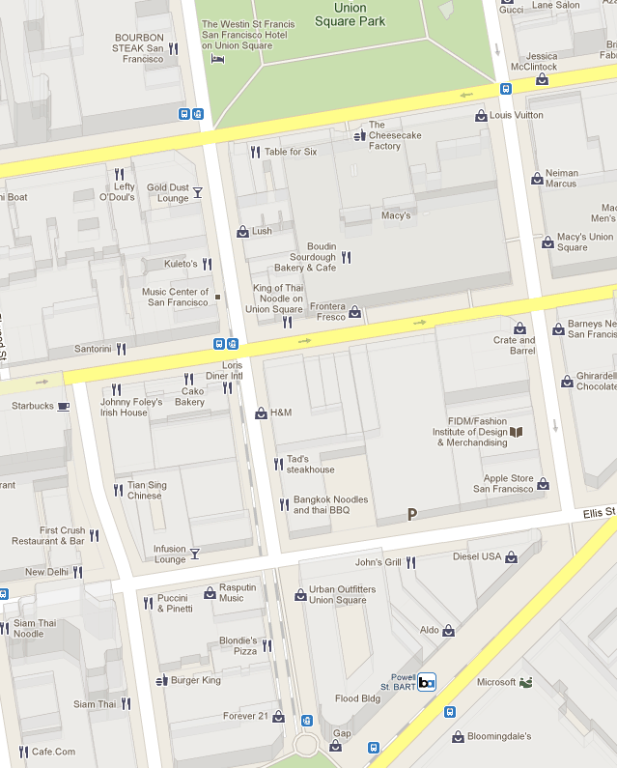

iPad
7:11 PM
Friend Finder
Menu
Item 1
Item 2
Item 3
Items
Friend Name
i
Location Properties
Directions To Here
Directions From Here
Address
700 Elis St
San Francisco California
94103
United States
Add to
Contacts
Share
Location
Add to
Favorites

Slide 9
iPad
7:11 PM
Button

Slide 10


Notification Title
7:26 am
Notification snippet line 1
Notification snippet line 2
iPad
7:11 PM
Facebook
Amir Khella
Amir Khella commented on his post: "how to create an interactive iPhone prototype"
Amir Khella commented on his post: "how to create an interactive iPhone prototype"

